Slide 1
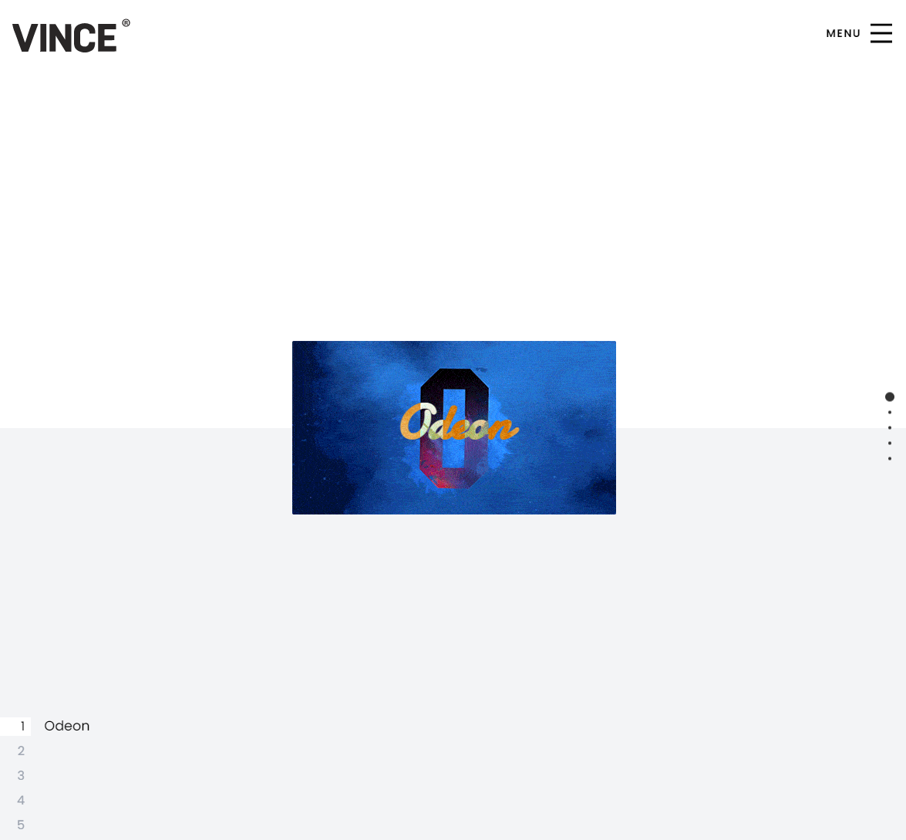
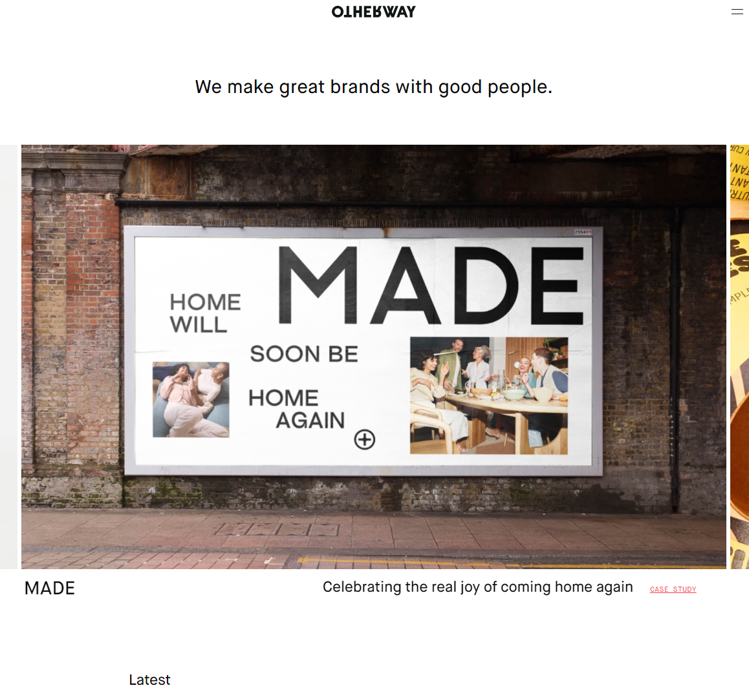
Front page
Change to this
- Small bit of info centred aligned at top.
- large ‘featured’ projects below that can scroll in carosel
Then some details of the project below that that scroll too
Then other work below that.
LIKE THIS : otherway.com (but with a bit more info of each project of each featured )

Slide 2
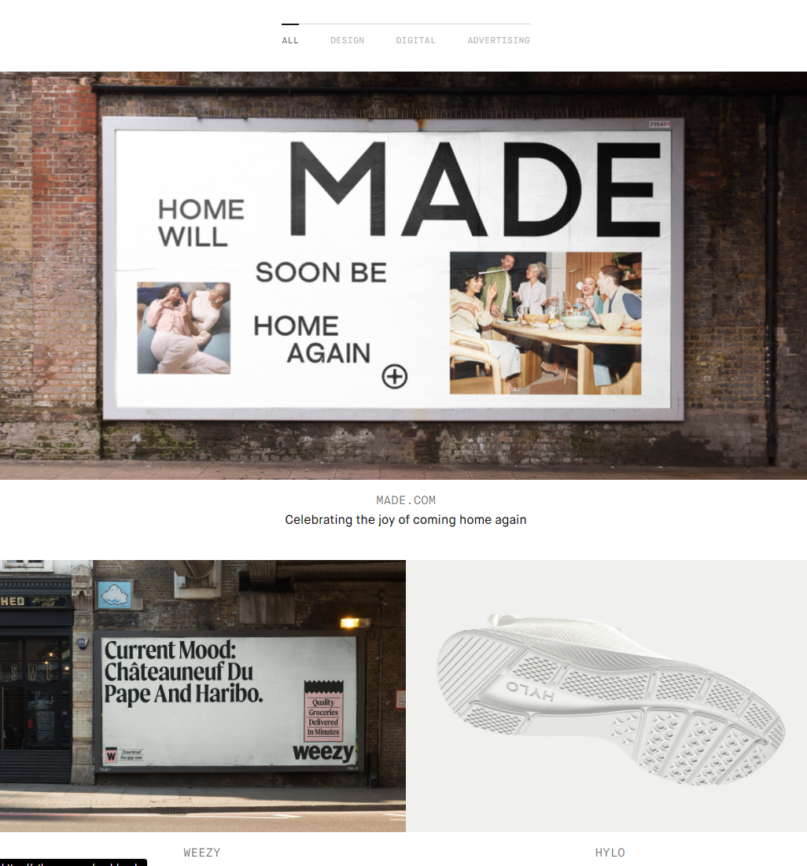
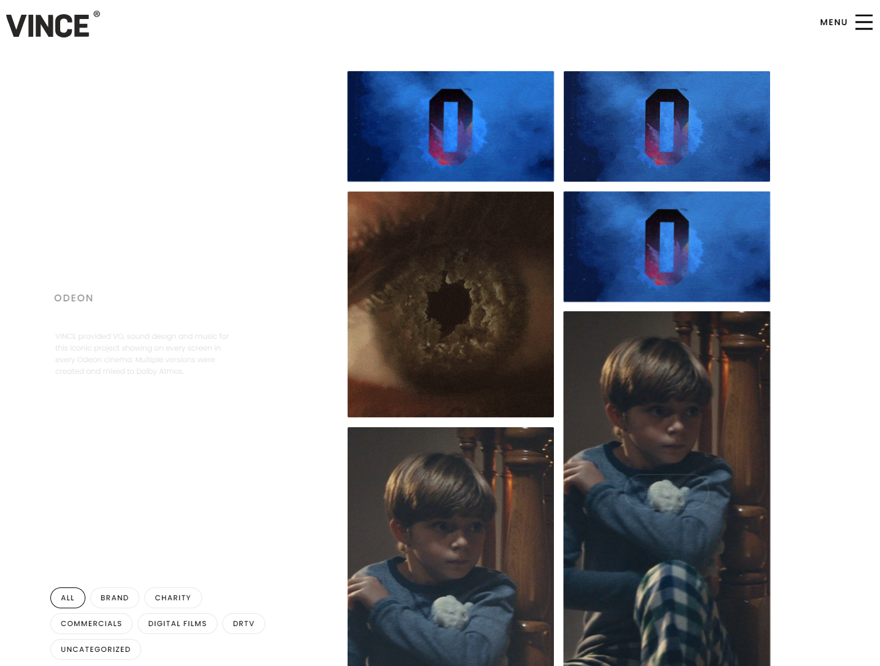
Work page
Change to similar to otherway.com (make responsive)

Slide 3
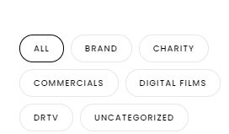
Other notes
Remote lozenge effect – just do nice box with thin stroke and highlight the selected with a reverse effect (so this would be ‘ALL’ on black with white text
Make whole site responsive
Change portfolio to ‘work’
Add in ‘services’ + ‘brands’ & ‘contact’

